Slide 1
What is a Theme?
“Thank You Ma’am”
by Langston Hughes

Slide 2
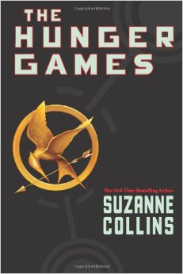
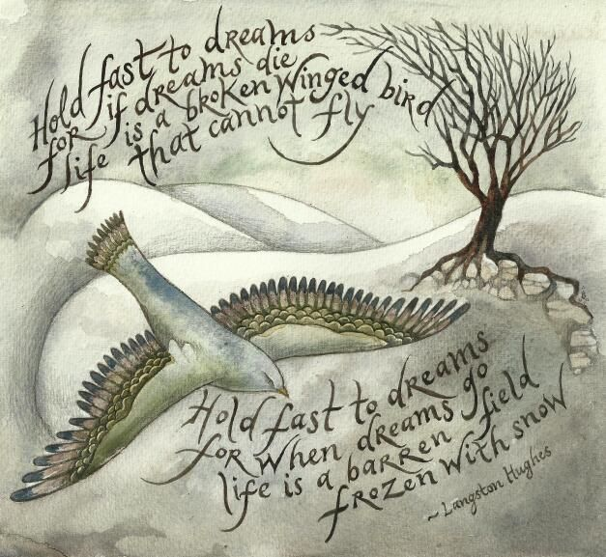
What is Theme?
Theme is the message
moral
lesson
of a literary work.

Slide 3
Message or Lessons about What?
Life:
What is most important in life?
What are life’s most difficult challenges and greatest joys?
Human Nature:
What are our best and worst qualities?
How should we treat each other?

Slide 4
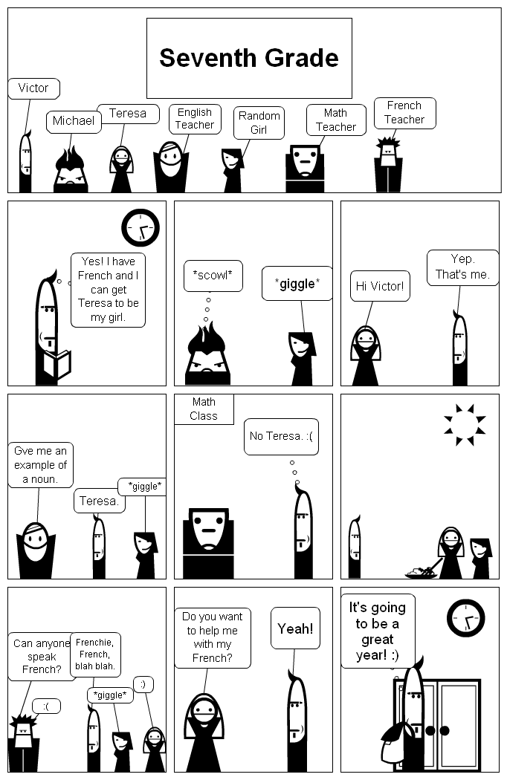
“Seventh Grade”
What is a possible theme?
Growing up can be awkward.

Slide 5
A Theme is not a Topic
Topics: Love
Friendship
Family
conquers all.
cannot be bought.
will always be there for you.
A theme is statement about a topic.

Slide 6
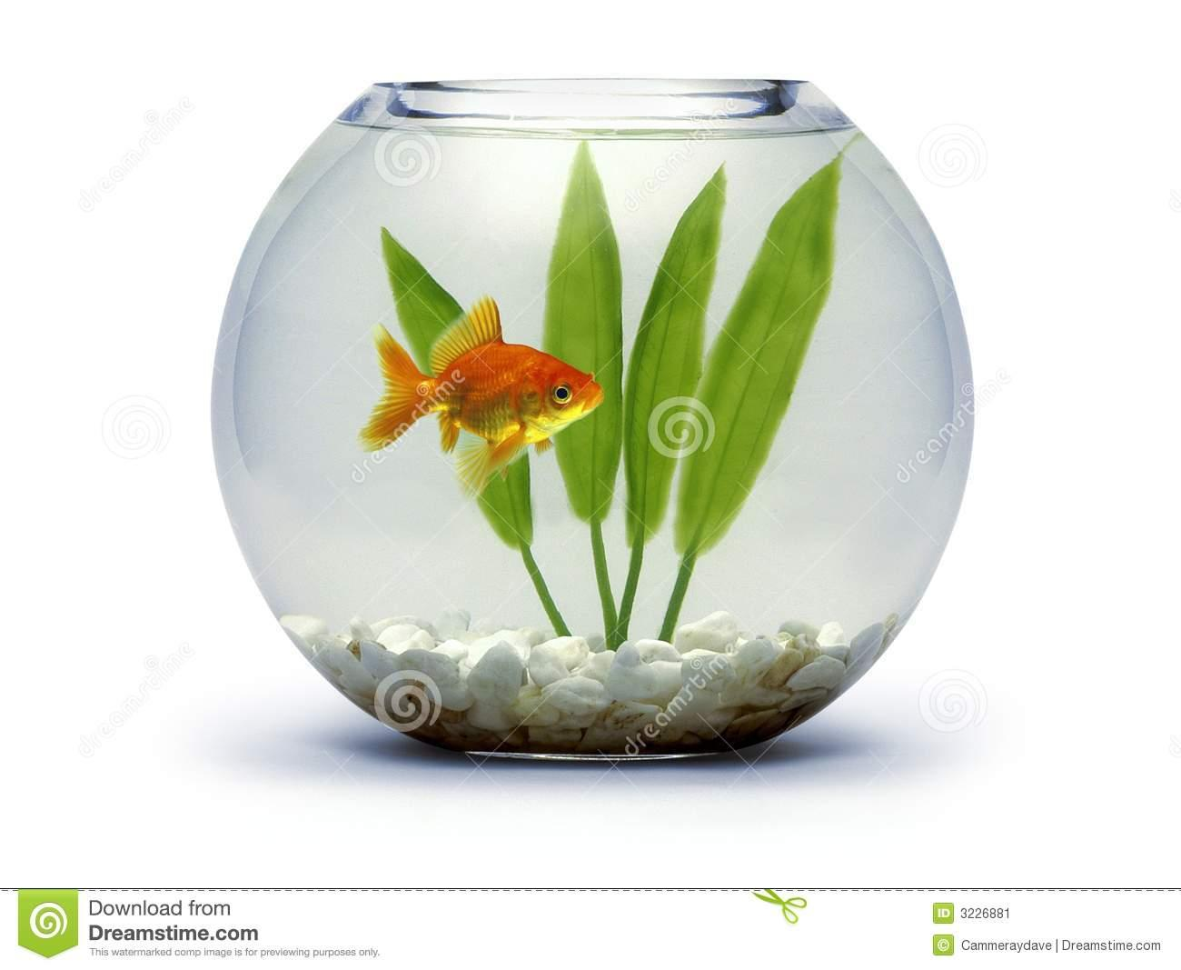
Themes Should be Universal
If you accidently kill your cousin’s goldfish, it’s better not to flush it and pretend nothing happened.
If you do something wrong, it’s better to be honest and admit it.

Slide 7
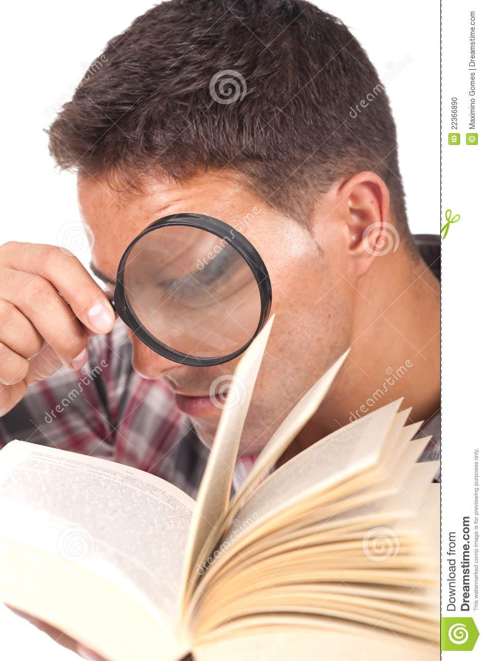
Themes must usually be Inferred.
You might find clues or evidence:
in the title;
in the character traits;
in the conflict.

Slide 8
Theme is Revealed Throughout the Story
You will find evidence at the beginning, middle, and end…
….and the ending is usually very important!

Slide 9
Reread “Thank You, M’am”
Pay careful attention to Mrs. Jones throughout the story.
What might her words and actions reveal about the theme?

